Slide 1
CS 772 : MID PROJECT EVALUATION
Parameter Efficient training for Multimodal Tasks
TEAM DETAILS
COURSE DETAILS
Team ID : 25
Course Title Deep Learning for Natural Language Processing
Instructor In-charge
Prof. Pushpak Bhattacharyya
TA Mentor
Tathagata Dey
Member Name | Roll No
Aditya Pande | 22M2108
Balbir Singh | 22M0747
Tarun Bisht | 23D0386
Vivek Kumar Trivedi | 22N0457

Slide 2
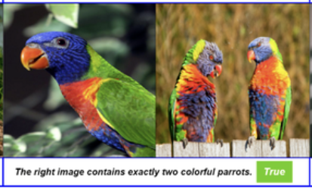
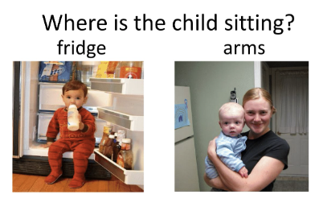
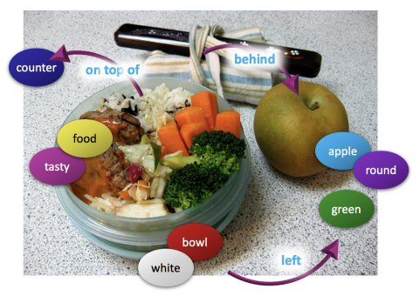
PROBLEM STATEMENT : Question Answering
Close Ended
NLVR2
Question Answering
VQA
Open Ended
GQA
NLVR2 (NL for Visual Reasoning)
VQA (Visual QnA)
GQA (General QnA)
Simple True/False questions on a pair of images
Open-ended questions about images. These questions require an understanding of vision, language and commonsense knowledge to answer
More fine tuned question
? Is the bowl to the right of the green
apple?
? What type of fruit in the image is round?

Slide 3
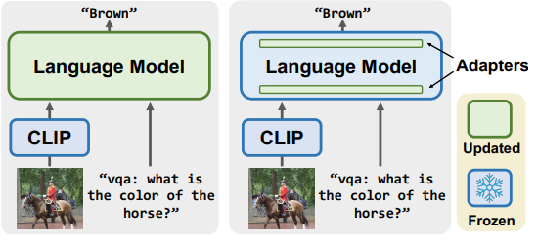
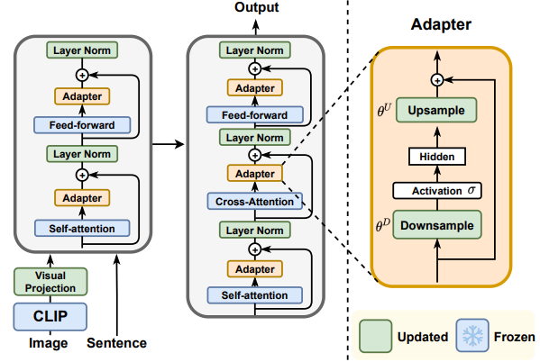
INPUT AND OUTPUT
General Representation of Vision-Language Model using CLIP encoder and Language mode (BART/T5) backbone
 | Full fine-tuning | Adapter training
Updated Parameters | 100% | 4%
Framework for V&L tasks using adapter based modules. Green AND yellow color refers to trainable parameters and blue color refers to frozen ones.

Slide 4
PROGRESS AND PLAN
Paper Understanding
Implementation of Vanilla Adapter,Hyper Former,Compactor,LoRA and prompt tuning
Retrieval Based Visual Question Answering [if time permits]
Full Fine Tuned on 3 Datasets (CLIP Encoder frozen)
Analyse these models for captioning tasks and assess its performance
Task | Accuracy (CLIP Encoder - BART LM) | Accuracy (Fast RCnn Encoder - BART LM)
NLVR2 | 74.236 | 72.3
VQA | 70.842 | 67.8
GQA | 55.569 | 57.3

Slide 5
THANKING
Prof. Pushpak Bhattacharyya SPECIAL THANKS TO Tathagata Dey

Slide 6
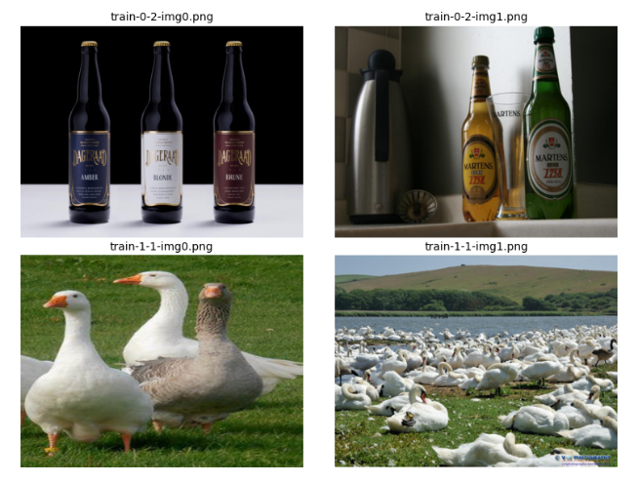
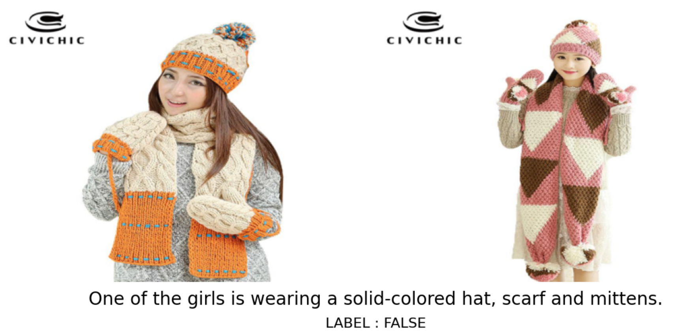
NLVR2 DATASET
Sample NLVR pairs
Classification task for the NLVR pair input and question
About the dataset
NLVR2 contains 107,292 examples of human-written English sentences grounded in pairs of photographs.
The task is to determine whether a sentence is true about a visual input.
solving the task requires reasoning about sets of objects, comparisons, and spatial relations.while including much more visually complex images.
PLEASE NOTE : This slide is not part of the presentation. This is a APPENDIX slide

Slide 7
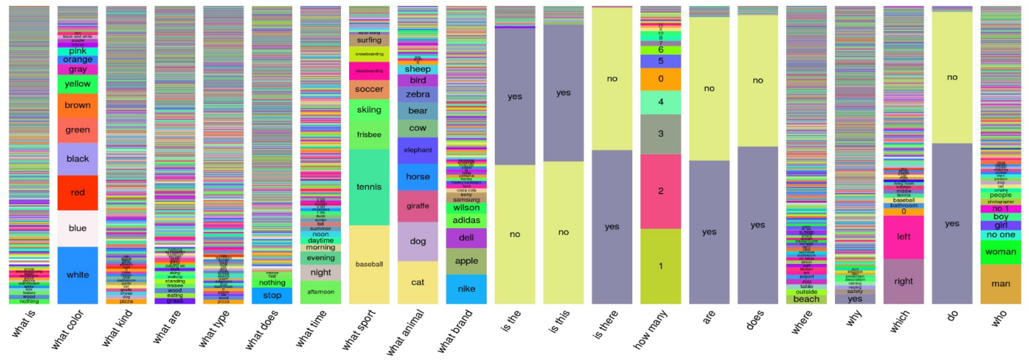
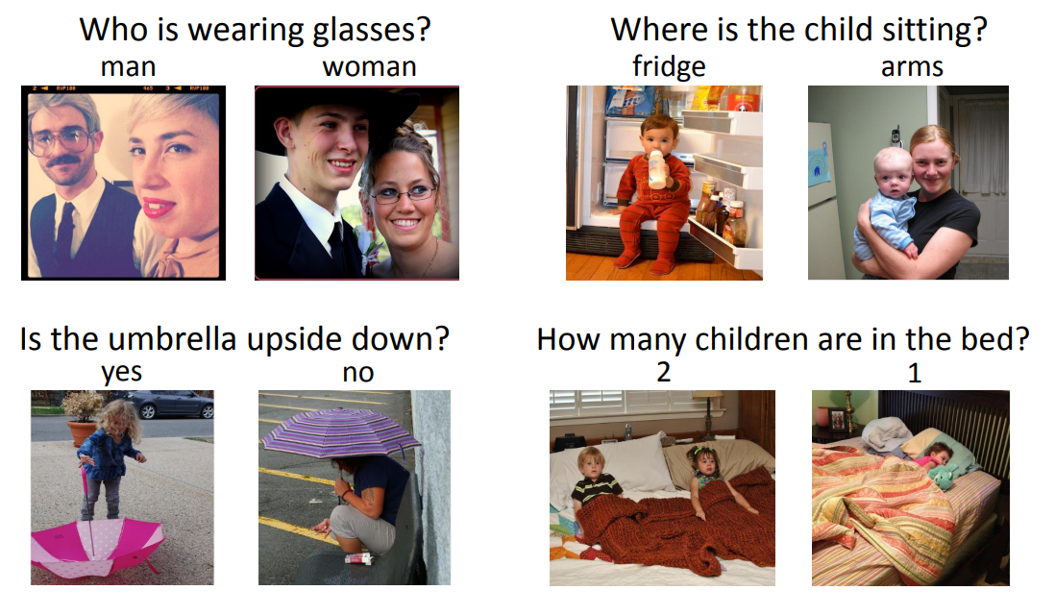
VQA V2.0 (Visual Question Answering) DATASET
Distribution of answers per question type for a random sample of 60K questions
Examples from Dataset
About the dataset
open-ended questions about images
204,721 COCO images
At least 3 questions (5.4 questions on average) per image
10 ground truth answers per question
3 plausible (but likely incorrect) answers per question
PLEASE NOTE : This slide is not part of the presentation. This is a APPENDIX slide

Slide 8
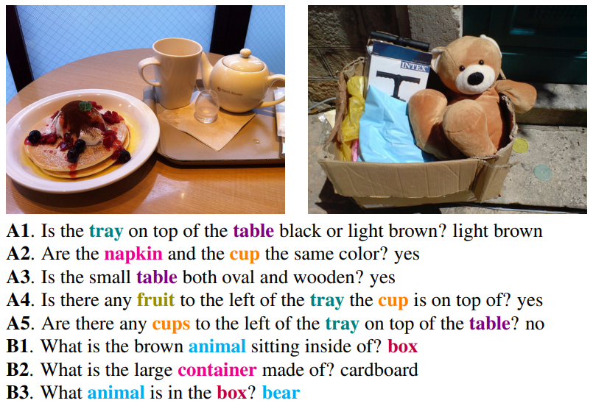
GQA DATASET
AA
AB
About the dataset
Dataset contains Images and related compositional reasoning questions
Questions are functional programs that represent scene semantics.
Contains 110K images and 22M questions.
Rectified flaw of previous dataset where, strong real-world priors displayed throughout the data.
Distribution of answers per question type for a random sample of 22M questions and 110K images
PLEASE NOTE : This slide is not part of the presentation. This is a APPENDIX slide

Slide 9
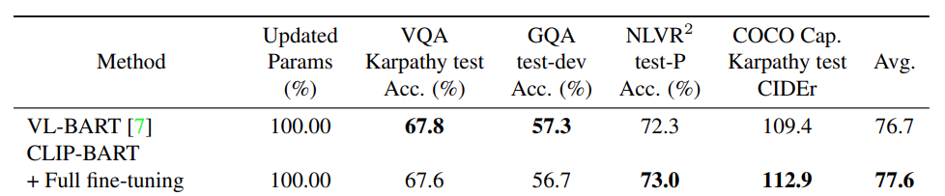
Paper Results & SOTA
Task | Model | Accuracy
NLVR2 | BEiT-3 | 92.58
VQA | PaLI | 84.3
GQA | CFR | 72.1
PLEASE NOTE : This slide is not part of the presentation. This is a APPENDIX slide

Slide 10
REFERENCES I
Neil Houlsby, Andrei Giurgiu, Stanislaw Jastrzebski, Bruna Morrone, Quentin De Laroussilhe, Andrea Gesmundo, Mona Attariyan, and Sylvain Gelly. Parameter-efficient transfer learning for nlp. In International Conference on Machine Learning, pages 2790–2799. PMLR, 2019.
Dan Hendrycks and Kevin Gimpel. Bridging nonlinearities and stochastic regularizers with gaussian error linear units. CoRR, abs/1606.08415, 2016.
Rabeeh Karimi Mahabadi, Sebastian Ruder, Mostafa Dehghani, and James Henderson. Parameter-efficient multi-task fine-tuning for transformers via shared hypernetworks. In Annual Meeting of the Association for Computational Linguistics, 2021.
Rabeeh Karimi mahabadi, James Henderson, and Sebastian Ruder. Compacter: Efficient low-rank hypercomplex adapter layers. In Thirty-Fifth Conference on Neural Information Processing Systems, 2021.
Edward J. Hu, Yelong Shen, Phillip Wallis, Zeyuan AllenZhu, Yuanzhi Li, Shean Wang, and Weizhu Chen. Lora: Low-rank adaptation of large language models. CoRR, abs/2106.09685, 2021
Brian Lester, Rami Al-Rfou, and Noah Constant. The power of scale for parameter-efficient prompt tuning. In EMNLP, 2021
aemin Cho, Jie Lei, Hao Tan, and Mohit Bansal. Unifying vision-and-language tasks via text generation. In Proceedings of the 38th International Conference on Machine Learning, volume 139, pages 1931–1942. PMLR, 18–24 Jul 2021
ash Goyal, Tejas Khot, Douglas Summers-Stay, Dhruv Batra, and Devi Parikh. Making the v in vqa matter: Elevating the role of image understanding in visual question answering. 2017 IEEE Conference on Computer Vision and Pattern Recognition (CVPR), pages 6325–6334, 2017
PLEASE NOTE : This slide is not part of the presentation. This is a APPENDIX slide

Slide 11
REFERENCES II
Xinlei Chen, Hao Fang, Tsung-Yi Lin, Ramakrishna Vedantam, Saurabh Gupta, Piotr Dollar, and C. Lawrence Zitnick. ´ Microsoft COCO captions: Data collection and evaluation server. CoRR, abs/1504.00325, 2015
aemin Cho, Jie Lei, Hao Tan, and Mohit Bansal. Unifying vision-and-language tasks via text generation. In Proceedings of the 38th International Conference on Machine Learning, volume 139, pages 1931–1942. PMLR, 18–24 Jul 2021
Sung, Y.L., Cho, J. and Bansal, M., 2022. VL-adapter: Parameter-efficient transfer learning for vision-and-language tasks. In Proceedings of the IEEE/CVF Conference on Computer Vision and Pattern Recognition (pp. 5227-5237)
Lewis, M., Liu, Y., Goyal, N., Ghazvininejad, M., Mohamed, A., Levy, O., Stoyanov, V. and Zettlemoyer, L., 2019. Bart: Denoising sequence-to-sequence pre-training for natural language generation, translation, and comprehension. arXiv preprint arXiv:1910.13461.
He, K., Zhang, X., Ren, S. and Sun, J., 2016. Deep residual learning for image recognition. In Proceedings of the IEEE conference on computer vision and pattern recognition (pp. 770-778).
Alec Radford, Jong Wook Kim, Chris Hallacy, Aditya Ramesh, Gabriel Goh, Sandhini Agarwal, Girish Sastry, Amanda Askell, Pamela Mishkin, Jack Clark, Gretchen Krueger, and Ilya Sutskever. Learning transferable visual models from natural language supervision. In ICML, 2021
Drew A Hudson and Christopher D Manning. Gqa: A new dataset for real-world visual reasoning and compositional question answering. Conference on Computer Vision and Pattern Recognition (CVPR), 2019
lane Suhr, Stephanie Zhou, Ally Zhang, Iris Zhang, Huajun Bai, and Yoav Artzi. A corpus for reasoning about natural language grounded in photographs. In Proceedings of the 57th Annual Meeting of the Association for Computational Linguistics, pages 6418–6428, Florence, Italy, July 2019. Association for Computational Linguistics
PLEASE NOTE : This slide is not part of the presentation. This is a APPENDIX slide

